Slide 1
MAP computer model of the auditory periphery
Ray Meddis
University of Essex, UK
rmeddis@essex.ac.uk

Slide 2
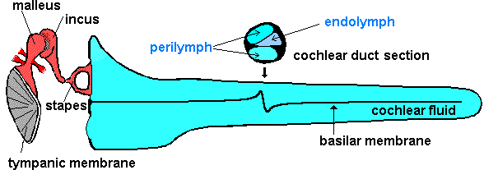
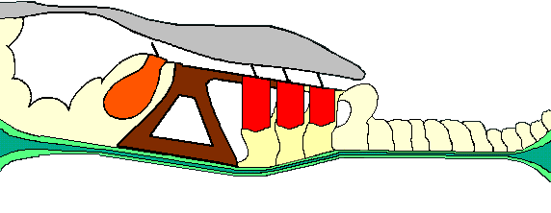

pure tone stimulus
stapes
BM motion
Stages of peripheral hearing
IHC stereocilia
receptor potential
transmitter release
auditory nerve
action potentials
Brainstem response

Slide 3
What is a computer model?
A model is a set of equations representing the physiological transformations of the signal between the eardrum and the brainstem
The equations are arranged in a cascade so that the output of one is used as the input of the next in the sequence
The equations and the parameters are all published and regularly improved

Slide 4
Downloadable
The software is free and can be downloaded across the internet
  http://www.essex.ac.uk/psychology/psy/PEOPLE/meddis/webFolder10/WebIntro.htm
programming language is MATLAB
software comes as a folder to drag and drop

Slide 5
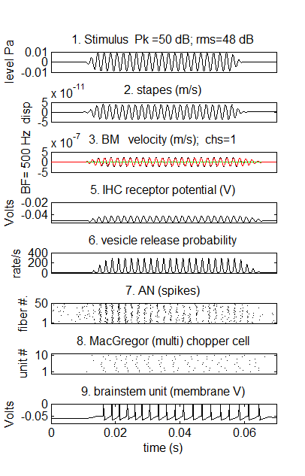
Example output

Slide 6
Demo programs

Slide 7
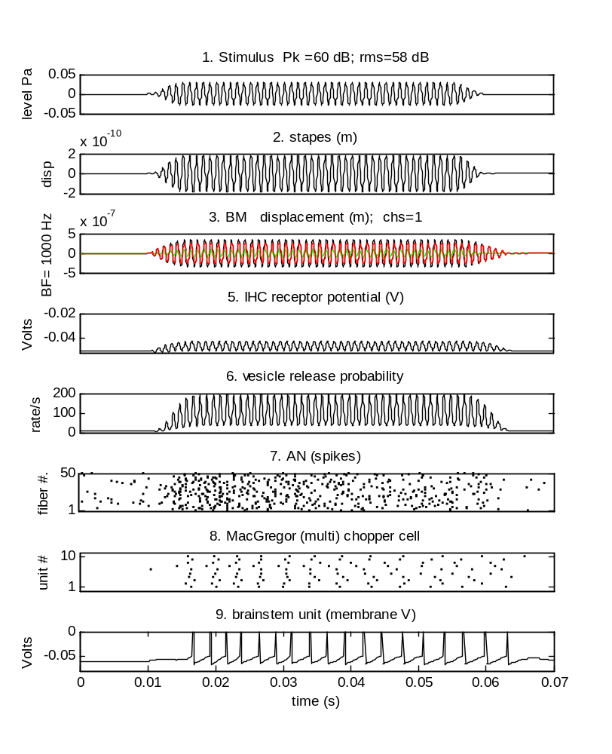
MAP demo single channel
BF= 1 kHz
stapes
BM
IHC receptor potential
IHC/ AN synapse
AN spikes
cochlear nucleus chopper
inferior colliculus chopper

Slide 8
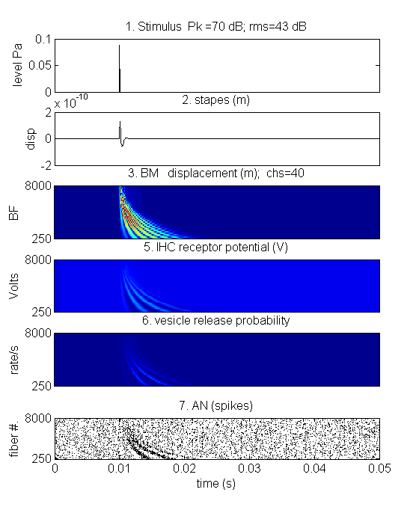
MAP demo multi-channel model
stapes
BM
IHC receptor potential
IHC/ AN synapse
AN spikes

Slide 9
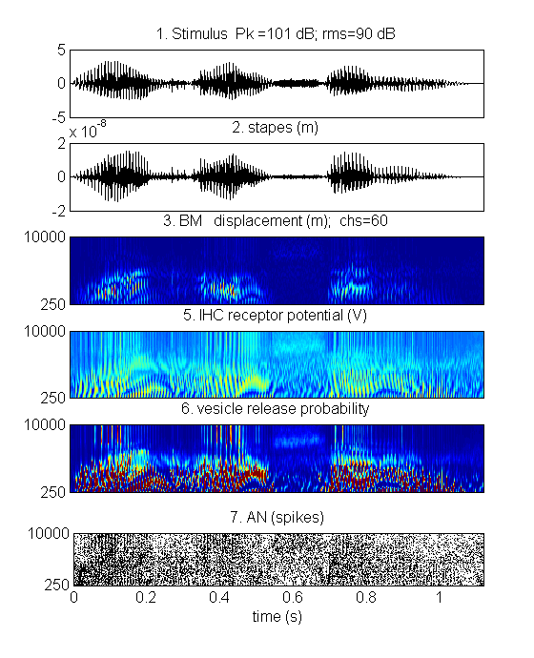
MAP speech demo
‘107’
(one oh seven)
stapes
BM
IHC receptor potential
IHC/ AN synapse
AN spikes

Slide 10
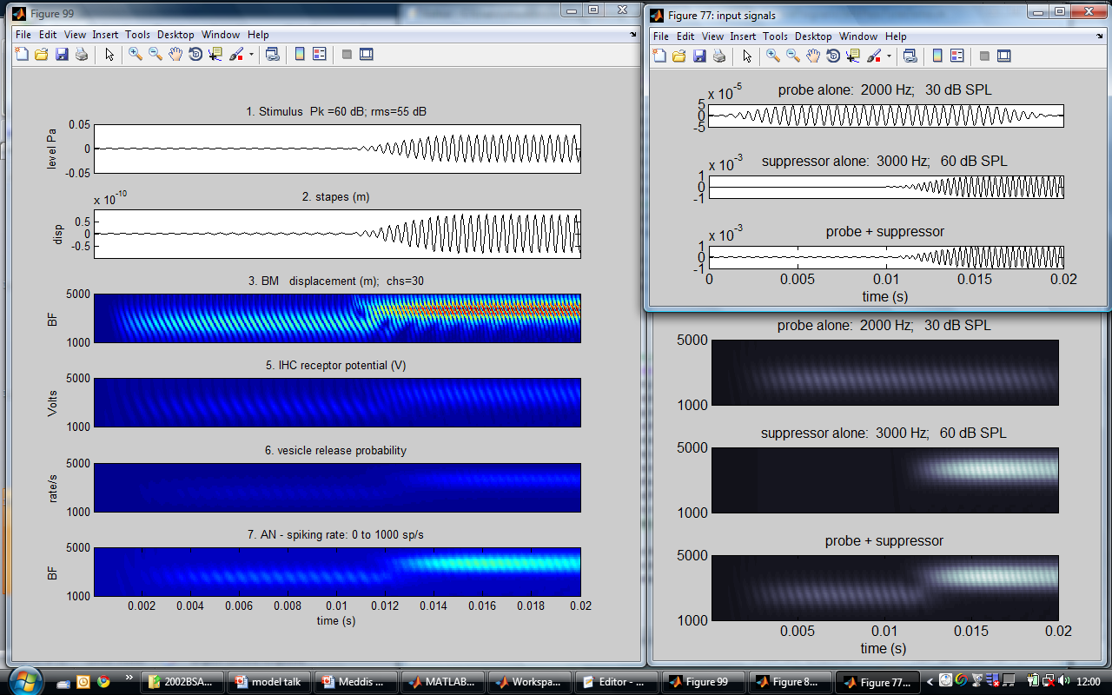
Multi-channel model
2-tone suppression example

Slide 11
Module sequence
1. stimulus
2. stapes
3. BM (4. IHC stereocilia)
5. IHC receptor potential
6. IHC/ AN synapse
7. AN spikes
8. CN chopper or primary-like
9. IC chopper or primary-like

Slide 12
Practicalities

Slide 13
Running the model
1. Generate the input signal
  inputSignal=zeros(1, 1000)
  inputSignal(50)=1; % click
  inputSignal=amp*inputSignal; % specify signal in µPa
2. Specify parameters
  method=MAPparamsDEMO(BFlist, sampleRate);
  method=plotGraphs=1;
3. Identify the modules to be used
  moduleSequence= [1 :7 ]; % up to auditory nerve
4. Run the module
  [earObject, method, A]=MAPsequenceSeg( inputSignal, method, moduleSequence);

Slide 14
Parameter files
(normal, impaired parameters supplied)
function method=MAPparamsDEMO(BFlist, sampleRate, showParams)
% module #1 inputStimulus
inputStimulusParams=[]; % clear the structure first
inputStimulusParams.sampleRate= 1/method.dt;
inputStimulusParams.boundaryValue=[];
% module #2 outerMiddleEar
outerMiddleEarParams=[]; % clear the structure first
outerMiddleEarParams.stapesScalar= 6e-008;
outerMiddleEarParams.dt= -1;
outerMiddleEarParams.filters= [0 900 2];
% module #4 IHC_cilia
IHC_ciliaParams=[]; % clear the structure first
IHC_ciliaParams.tc= 0.0003;
IHC_ciliaParams.C= 0.1;
IHC_ciliaParams.Gmax= 8e-009;
IHC_ciliaParams.Gu0= 1.974e-009;
IHC_ciliaParams.u0= 7e-009;
IHC_ciliaParams.s0= .25e-007;
IHC_ciliaParams.u1= 7e-009;
IHC_ciliaParams.s1= 10e-009;
IHC_ciliaParams.u0= 40e-009;
IHC_ciliaParams.s0= 1.e-007;
IHC_ciliaParams.u1= 7e-009;
IHC_ciliaParams.s1= 20e-009;
% module #5 IHC_RP
IHC_RPParams.Cab= 16e-012; % IHC capacitance (F)
IHC_RPParams.Et= 0.11; % endocochlear potential (V)
IHC_RPParams.Gk= 1.8e-008; % potassium conductance (S)
IHC_RPParams.Ek= -0.0705; % potassium equilibrium potential
IHC_RPParams.Rpc= 0.04; % combined resistances
% module #6 IHCpreSynapse
IHCpreSynapseParams.GmaxCa= 8e-009; % maximum calcium conductance
IHCpreSynapseParams.ECa= 0.066; % calcium equilibrium potential
IHCpreSynapseParams.beta= 400; % parameters determining channel opening
IHCpreSynapseParams.gamma= 130; % parameters determining channel opening
IHCpreSynapseParams.tauM= 0.0001; % membrane time constant
IHCpreSynapseParams.tauCa=tauCas; % calcium clearance (LSR first)
IHCpreSynapseParams.power= 3; %
IHCpreSynapseParams.z= 2e42; % scalar Ca -> vesicle release rate
% module #7 AN_IHCsynapse
AN_IHCsynapseParams.mode= 'spikes';
% AN_IHCsynapseParams.mode= 'probability'; % faster
AN_IHCsynapseParams.M= 12; % maximum number of vesicles in available store
AN_IHCsynapseParams.y= 3; % rate of replacement of lost vesicles (vesicles/s)
AN_IHCsynapseParams.y= 10; % rate of replacement of lost vesicles (vesicles/s)
AN_IHCsynapseParams.l= 2580; % rate of loss of vesicles from the cleft
AN_IHCsynapseParams.x= 30; % rate of replenishment from the re-uptake store
AN_IHCsynapseParams.r= 6580; % rate of reuptake from the cleft into the cell
AN_IHCsynapseParams.refractory_period= 0.00075;
AN_IHCsynapseParams.PSTHbinWidth= 0.001;

Slide 15
Brainstem units

Slide 16
Adding brainstem units
AN CN chopper IC chopper
Different kinds of brainstem units can be used
(e.g. primary-like, pauser, build-up

Slide 17
MAP demo with brainstem units
stapes
BM
IHC receptor potential
IHC/ AN synapse
AN spikes
cochlear nucleus chopper
inferior colliculus chopper

Slide 18
Latest news: efferent system

Slide 19
pure tone stimulus
New feedback loops
stapes
BM motion
IHC stereocilia
receptor potential
transmitter release
auditory nerve
action potentials
MOC
efferents
Brainstem response
acoustic
reflex

Slide 20
Doing psychophysics
The first step is to get the model to make decisions
Threshold decisions
  did you hear it?

Slide 21
Stimulus is above threshold if at least one spike occurs

Slide 22
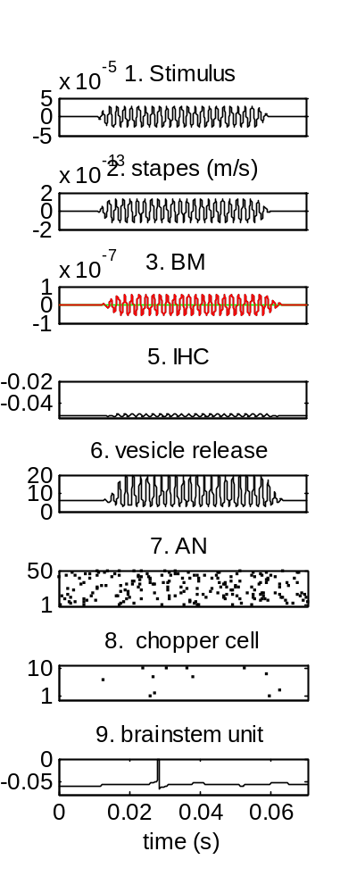
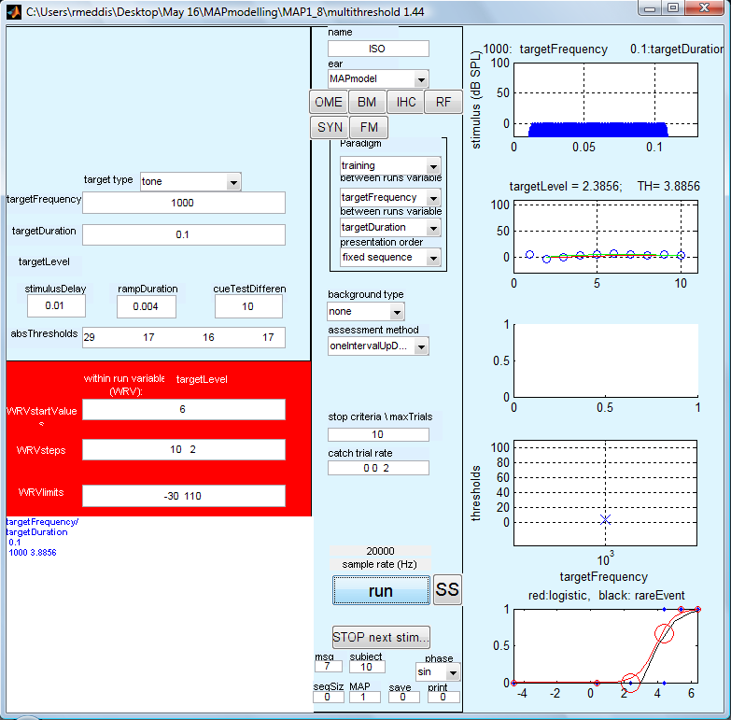
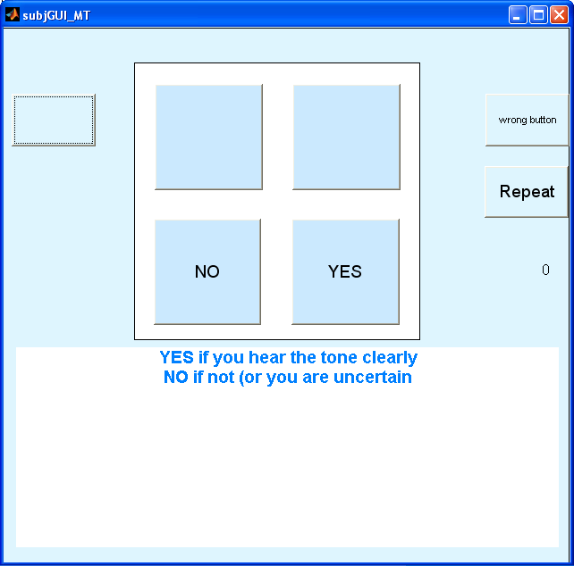
Psychophysical evaluation of the model
experimenter model
model makes the decisions and presses the buttons

Slide 23
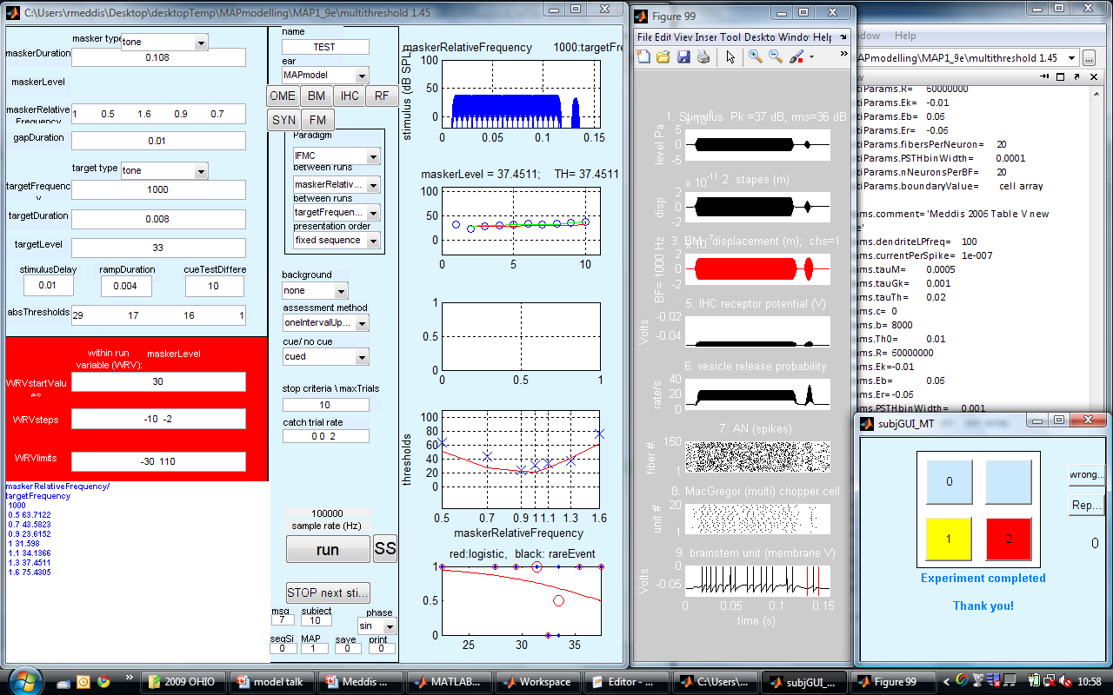
Forward masking paradigm

Slide 24
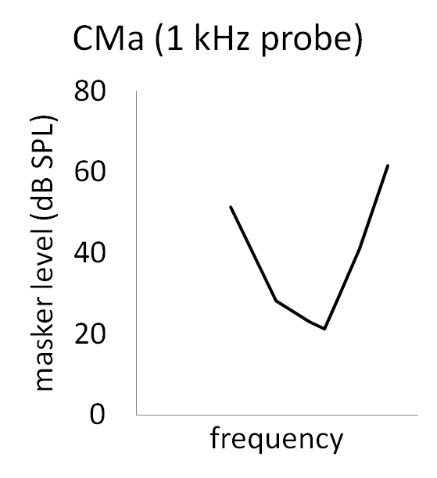

iso-forward masking contour
(IFMC)
masker probe
108 ms
variable
frequency
8 ms
2 kHz
10 dB SL
10 ms gap
masker level
Vary masker frequency

Slide 25
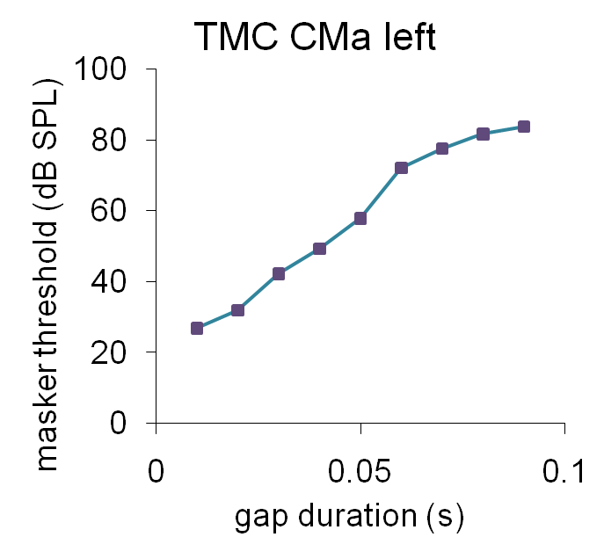




TMC (temporal masking curve)
masker probe
2 kHz 2 kHz
variable gap

Slide 26
model (CMa) data
100
1000
10000
-
100
1000
10000

Slide 27
Thank you!

Slide 28
Multi-channel brainstem model
AN CN chopper IC chopper
BF1
BF2
BF3

